Slide 1
A COMPARATIVE STUDY ON SELECTED MACRO VARIABLES OF GDP USING EXPLORATORY ANALYSIS, AND EVALUATING DIFFERENT TIME SERIES MODEL

Slide 2
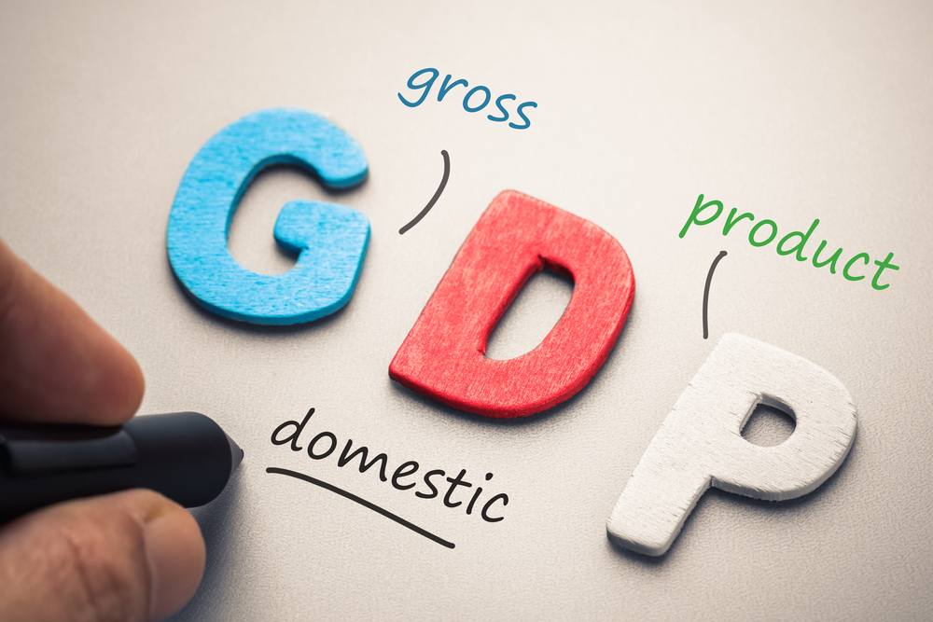
Roll No. Name
02 Akshay N. Vanjare
18 Lait R. Alone
Project Guide:
Ms Rupal C. Rabari
Mr. Agniva Das

Slide 3
ABSTRACT
GDP is an indicator of the growth of an economy.
Financial Architecture aims sustainability of an economy by ensuring consistent growth rate.
Higher GDP of an economy reflects robust growth of an economy and vice-versa and as such every country tries to maximize the growth rate of GDP.
There are certain macro factors operating in the economic environment that will influence the GDP growth rate.

Slide 4
OBJECTIVES
The main objectives of the study are:
To identify the relationship between selected economic variables and GDP of Indian Economy.
To analyze the impact of selected economic variables on GDP of Indian economy.
To briefly overview the trends in Indian GDP and its related sector such as Agriculture, Service, Manufacturing, Export, Import etc. in India and study of change in contribution of different sector in Indian GDP and estimate it for future Trend.

Slide 5
WHAT IS GDP?
Gross domestic product (GDP) is the market value of all officially recognized final goods and services produced within a country in a given period of time.
It does not include the incomes of NRI’s.
In simple terms GDP is the national income of a country in a given period of time.
It is one of the measure of the size of economy .
It is an indicator of economic health of a country
Notes:
Insert a picture of one of the geographic features of your country.

Slide 6
History OF GDP
GDP first came to light 1937 in a report to the U.S. Congress in response to the Great Depression, conceived of and presented by an economist at the National Bureau of Economic Research, Simon Kuznets. At the time, the preeminent system of measurement was GNP. After the Bretton Woods conference in 1944, GDP was widely adopted as the standard means for measuring national economies,
Notes:
Insert a picture illustrating a season in your country.

Slide 7
Equation of gdp
The equation of GDP is:
GDP = C + G + I + (E - I)
Consumption (C) - Includes personal consumption goods.
Government Purchases (G) - This category includes government spending various items.
Investment (I) - Includes Gross Private Investments such as Fixed Deposits etc.
Net Exports (E-I)- This is calculated by subtracting a nations imports (I) from exports (E).
Notes:
Insert a picture of an animal and or plant found in your country.

Slide 8
The selected variables are
Agriculture
Mining & Querrying
Manufacturing
Electricity Gas &Water supply
Construction
Trade
Financial real estate & personal services
Public Administration
Gross National Income
Net National Income
Per Capita Income
Private Final Consumption Expenditure
Government Final Consumption Expenditure
Changes in Stocks
Valuables
Export
Less Import

Slide 9
methodology
Sources of Data
The data is collected by using secondary sources relating to the selected economic variables. Annual data is collected for a period from 1950-51 to 2018-19, Quarterly data is collected for a period from 2000-01 to 2019-20. And state wise data is collected for a period from 1980-81 to 2019-20.
Tools Used in Analysis
Normality Test
Durbin-Watson test
Breusch-Godfrey test
Goldfeld-Quant test
VIF
Principal Component Analysis
Principal Component Regression
ARIMA
Forecasting

Slide 10
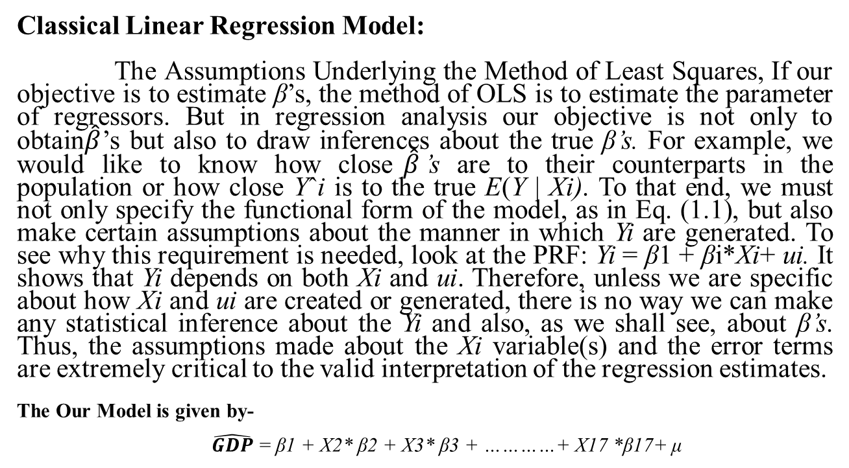
Theory
Classical Linear Regression Model:
The Assumptions Underlying the Method of Least Squares, If our objective is to estimate β’s, the method of OLS is to estimate the parameter of regressors. But in regression analysis our objective is not only to obtain$\hat{β}$’s but also to draw inferences about the true β’s. For example, we would like to know how close$\hat{β}$’s are to their counterparts in the population or how close Yˆi is to the true E(Y | Xi). To that end, we must not only specify the functional form of the model, as in Eq. (1.1), but also make certain assumptions about the manner in which Yi are generated. To see why this requirement is needed, look at the PRF: Yi = β1 + βi*Xi+ ui. It shows that Yi depends on both Xi and ui. Therefore, unless we are specific about how Xi and ui are created or generated, there is no way we can make any statistical inference about the Yi and also, as we shall see, about β’s. Thus, the assumptions made about the Xi variable(s) and the error terms are extremely critical to the valid interpretation of the regression estimates.
The Our Model is given by-
$\hat{GDP}$ = β1 + X2* β2 + X3* β3 + …………+ X17 *β17+ μ

Slide 11
CLRM Assumptions:
Regression linear in parameters.
Error term has zero population mean
Error term not correlated with x’s
No serial correlation
No heteroscedasticity
No perfect multicollinearity
Error usually normally distributed

Slide 12
Analysis and Interpretation
Normality Test (Shapiro.test)
Null hypotheses: Data follow normal.
Alternative hypothesis: Data not follow normal.
w = 0.96091, p-value = 0.05548
Interpretation:
Calculated p-value is greater than tabulated p-value 0.05 (alpha). Then our data is follows normal.

Slide 13
Analysis and interpretation
Test for Autocorrelation (Durbin-Watson test), AR(1)
DW = 1.6311, p-value = 0.001123
Interpretation: From the DW test, there is present of autocorrelation in the data.
(For remove autocorrelation, we have use different autoregressive i.e. AR(2))
Test for Autocorrelation (Durbin-Watson test)
DW = 2.0103, p-value = 0.1016
Interpretation: we conclude that DW-statistics value “d” is near to 2 therefore there is no autocorrelation in the data. To remove serial correlation we used AR model. And we conclude second iteration to remove serial correlation in the model.

Slide 14
Analysis and interpretation
Test for Homoscedasticity (Breusch-Godfrey test)
Null hypothesis: Data is Homoscedasticity.
Alternative hypothesis: Data is not Homoscedasticity.
LM test = 2.819, df = 1, p-value = 0.9315
Test for Homoscedasticity (Goldfeld-Quant test)
GQ = 0.42874, df1 = 13, df2 = 12, p-value = 0.928
Interpretation: The calculated p-value is greater than tabulated p-value (alpha 0.05) so we can say both test conclude that data is homoscedastic.

Slide 15
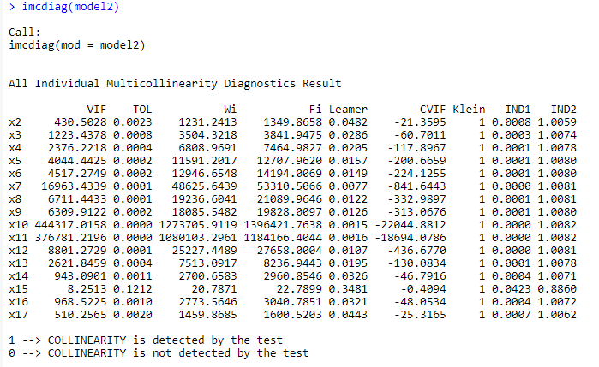
Analysis and interpretation
Test for Multicollinearity (VIF)
Interpretation:From the calculated all variables VIF values is greater than 5, there is present of multicollinearity in the data.

Slide 16
Analysis and interpretation
How to Deal with Multicollinearity
Remove some of the highly correlated independent variables.
Linearly combine the independent variables, such as adding them together.
Perform an analysis designed for highly correlated variables, such as principal components analysis or partial least squares regression.
We deal with multicollinearity for removing by Using PCA.

Slide 17
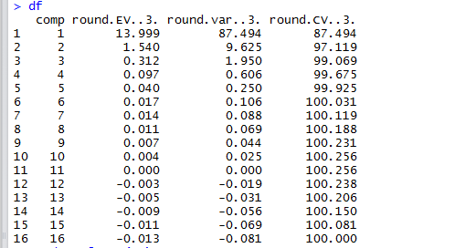
Analysis and interpretation
Principal Component Analysis
Interpretation:
The first component explains 87.494% variation of the data set. Second component explains 9.625 percent of the variation. The first second components explain around 97.1 per cent variation in the data set. We extract only first two component and total variation explain of second component is 97 per cent.

Slide 18
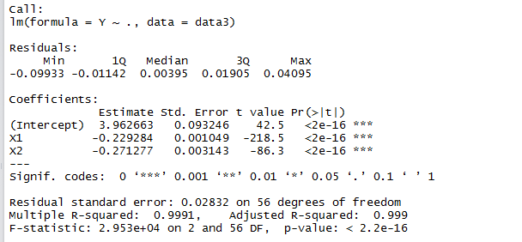
Analysis and interpretation
Principal Component Regression
Interpretation: From the principal component regression with the original dependent variable GDP the model is good. The entire components are significant effect in the given data with R-squared value 0.991.

Slide 19
Analysis and Interpretation
Now we goes to TIME SERIES analysis for forecast GDP.
There are two types of data.
1. Annual Forecast of GDP:
There are 67 observation in the data means annual GDP start from 1953 to end 2020.
2. Quarterly Forecast of GDP
There are 20 observation in the data means Quarterly GDP start from 2000-01 to end 2019-20.

Slide 20
Analysis and Interpretation
ARIMA (Annually)
Stationary (Augmented Dickey-Fuller Test)
H0: Data is non-stationary.
Ha: Data is stationary
Dickey-Fuller = -3.7564, Lag order = 4, p-value = 0.02684
Alternative hypothesis: stationary
Interpretation:
Here the p-value displayed as 0.027, assuming significance alpha = 0.05,we reject the null hypothesis and classify this as stationary.

Slide 21
Analysis and interpretation
Box-Ljung test for annual GDP
H0: The model does not exhibit lack of fit.
Ha: the model exhibits lack of fit. (time series isn't autocorrelated)
X-squared = 21.709, df = 20, p-value = 0.3565
Interpretation:
The test statistic of the test is Q = 21.709 and the p-value of the test is 0.3565, which is much larger than 0.05. Thus, we fail to reject the null hypothesis of the test and conclude that the time series is autocorrelated.

Slide 22
Analysis and Interpretation
Annual GDP Forecast
The above figure forecast of annual GDP growth for the next ten years we can see the output to next 2021 to 2030 years forecast.
Years | Annual GDP Forecast next 10 Years
2021 | 7.3387
2022 | 6.6747
2023 | 6.8152
2024 | 6.7855
2025 | 6.7917
2026 | 6.7904
2027 | 6.7907
2028 | 6.7906
2029 | 6.7906
2030 | 6.7906

Slide 23
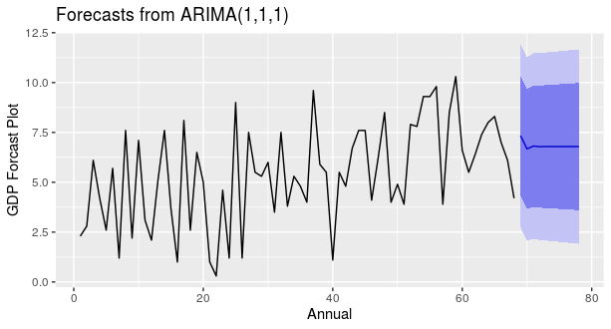
Analysis and Interpretation
Forecast Plot form ARIMA Model with parameters(1,1,1)
The above Forecast GDP plot its annual GDP forecast is slowly downward direction for next ten years forecast values.

Slide 24
Analysis and Interpretation
Annual GDP Forecast
Model Accuracy
>accuracy(Annual_Forecast)
Interpretation:
The above time series analysis for GDP forecasting for Annual data. We can see the data is already stationary. And the Annual data are the forecast is pretty good up to next 10 years. GDP starting from 1953 to ending 2020. And the ending of the 2020 GDP rate is 4.2. And next 10 Years forecast in smoothly down GDP rate up to next 10 Years
ME | RMSE | MAE | MPE | MAPE | MASE | ACF1
0.413 | 2.289 | 1.864 | -42.601 | 72.933 | 0.681 | -0.033

Slide 25
Analysis and interpretation
ARIMA (Quarterly)
Stationary (Augmented Dickey-Fuller Test)
H0: Data is non-stationary.
Ha: Data is stationary
Dickey-Fuller = -2.4136, Lag order = 4, p-value = 0.4065
Alternative hypothesis: stationary
Interpretation:
Here the p-value displayed as 0.4065, assuming significance alpha = 0.4065, we accept the null hypothesis and classify this as not stationary, we have to decompose data.

Slide 26
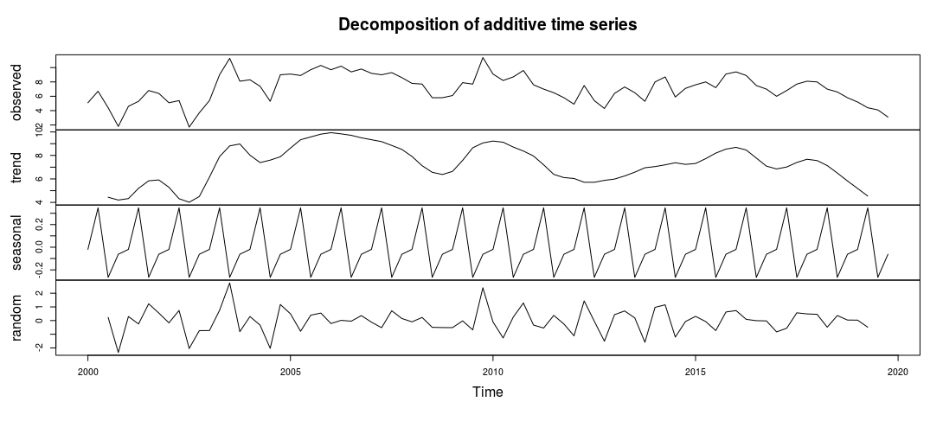
Analysis and interpretation
Decompose Data
Here we decompose of the time series data with additive type, there is present the seasonality and randomness in the data.

Slide 27
Analysis and interpretation
Box-Ljung test for Quarterly GDP
H0: The model does not exhibit lack of fit.
Ha: the model exhibits lack of fit. (time series isn't autocorrelated)
X-squared = 16.033, df = 18, p-value = 0.5902
Interpretation:
The test statistic of the test is Q = 16.033 and the p-value of the test is 0.5902, which is much larger than 0.05. Thus, we fail to reject the null hypothesis of the test and conclude that the data values are independent.

Slide 28
Analysis and Interpretation
Quarterly GDP Forecast
The above figure forecast of Quarterly GDP growth for the next five years we can see the output to next 2020-21 to 2024-25 years forecast.
Here we can see the forecast for quartile GDP rate up to next five years.
Years | 2020-21 |  |  |  | 2021-22
Quarter | Q1 | Q2 | Q3 | Q4 | Q1 | Q2 | Q3 | Q4
Quartiles GDP forecast | 4.186 | 4.967 | 5.528 | 5.931 | 6.221 | 6.429 | 6.579 | 6.686
2022-23 |  |  |  | 2023-24 |  |  |  | 2024-2025
Q1 | Q2 | Q3 | Q4 | Q1 | Q2 | Q3 | Q4 | Q1 | Q2 | Q3 | Q4
6.764 | 6.819 | 6.859 | 6.888 | 6.908 | 6.923 | 6.934 | 6.941 | 6.947 | 6.951 | 6.954 | 6.956

Slide 29
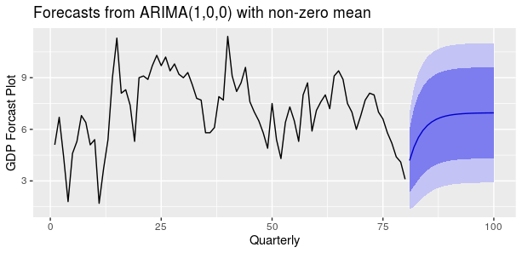
Analysis and Interpretation
Forecast Plot form ARIMA Model with parameters(1,1,1)
The above Forecast GDP plot its Quarterly GDP forecast is slowly downward direction for next five years forecast values.

Slide 30
Analysis and Interpretation
Annual GDP Forecast
Model Accuracy
>accuracy(Annual_Forecast)
Interpretation:
Finally we see the above Quartile GDP forecasting for the next five years with respective quartiles. And look at the forecast plot the value of forecast is increasing direction. So the quartile forecast is best forecast in the above ARIMA Model (1, 0, 0) with non-zero mean.
ME | RMSE | MAE | MPE | MAPE | MASE | ACF1
0.024 | 1.419 | 1.107 | -6.815 | 20.415 | 0.936 | 0.013

Slide 31
Analysis and interpretation
GDP (constant LCU) Vs Years (1960 – 2018)
Interpretation:
The above GDP graph is the constant value of local currency unit in India. The trend is the monotonically increasing to upward direction, and the linear line is well the accuracy in line is 79% in the linear line with respective parameters.

Slide 32
Analysis and interpretation
Agriculture (constant LCU) Vs Years
Interpretation:
In the above fig, you can see the trend of agriculture is increasing in exponential growth.

Slide 33
Analysis and interpretation
Manufacturing, value added (constant LCU)
Interpretation:
In the above fig, manufacturing increasing in price to every year up to 2018. There are exponentially increasing trend in price of manufacturing factor.

Slide 34
Analysis and interpretation
Import – Export trend.
Interpretation:
The Import – Export trend is also increasing trend, but mostly we seen the trend of Export is less than Import. That is the Net export trend is also affect on GDP to improve Indian Economy.

Slide 35
Conclusion
The Above analysis we conclude that the classical linear regression model we can see the some assumption is violated and how its deal systematically first we data transformed for normality and linearity assumption, after we goes no autocorrelation assumption there are also violated, then we tackle the problem of autocorrelation help of AR model after we check the multicollinearity its also violated then we used to remove multicollinearity in data using Principal component analysis and remove the multicollinearity in the data.

Slide 36
Now all the classical linear regression model satisfy. Last we remove the multcollinearity problem in data using PCA. In PCA first two component is more amount of variation in the original data. Then we extract first two PCs components. And Regress first two PCs component and its also know as Principal Component regression model. Then we estimate the parameters of original variable help of weighted matrix to multiply my PCs component coefficient and get the original classical linear regression model variables with best accuracy R-squares value is very close to one.
Then we goes to Time series analysis and forecast the Annual GDP and Quarterly GDP for future values of GDP.

Slide 37
References
https://www.rbi.org.in/Scripts/AnnualPublications.aspx?head=Handbook%20of%20Statistics%20on%20Indian%20Economy/
http://mospi.nic.in/data: secondary data for annually and quarterly GDP data collected.
https://data.worldbank.org/indicator/NY.GDP.PCAP.CD?locations=AF&start=1971
Basic Econometrics by Damodar N. Gujrati (Book)
https://uclspp.github.io/PUBL0055/seminar8.html
http://www.kse.org.ua/uploads/file/library/2003/Demchuk.pdf
http://www.diva-portal.org/smash/get/diva2:664110/FULLTEXT01.pdf
http://dergipark.gov.tr/download/article-file/364168

Slide 38
Thank you

